Slide 1

Keyes Community Services District
Board of Directors Workshop
FEBRUARY 4, 2023
10:00 a.m.
Keyes Community services district
5601 7th Street, keyes ca 95328

Slide 2
WELCOME

Slide 3
No formal action will be commenced at the workshop. The workshop is a forum for collecting information for possible future board action.

Slide 4

INTRODUCTION
Board Members
Cody Knee, President
Johnathon Parker, Vice President
Ron Reforma, Director
Michelle Bernal, Director
Kristina Vasquez, Director
Staff
Ernie Garza, General Manager
Michelle Harris, Administrative Executive
Mike Jones, Maintenance Operations Director
Kevin Showen, Maintenance Operations Supervisor
Mario Gouveia, Engineer
Danny Reed, Engineer
Dennis L. Hay, Attorney

Slide 5
CAL CAD GIS presentation by
Robert Spiva.

Slide 6
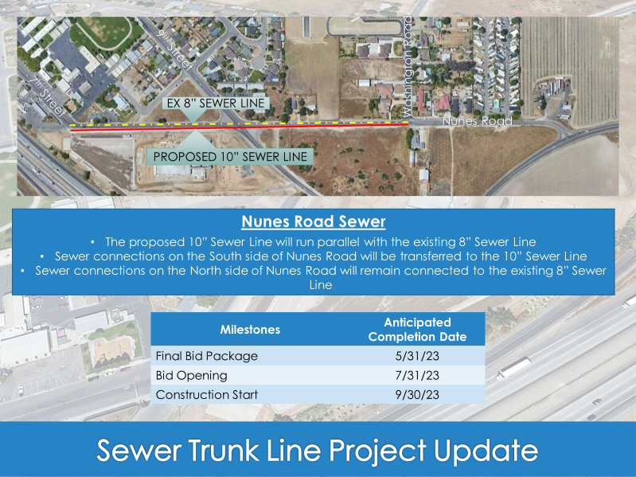

Slide 7
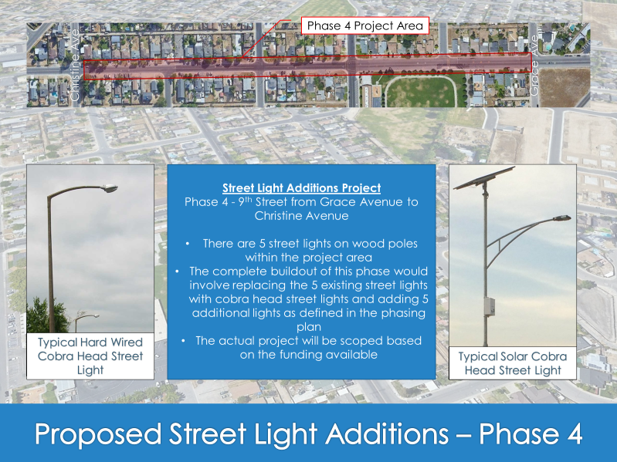

Slide 8
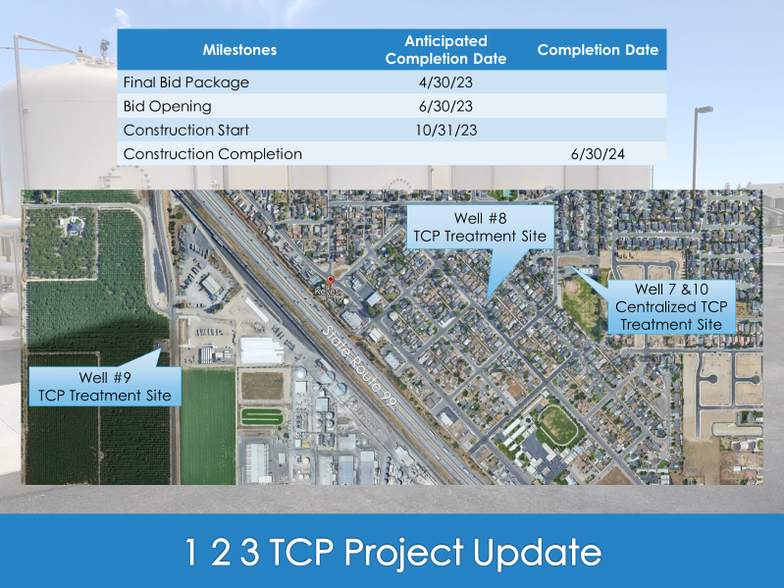

Slide 9

CASH BALANCE

Slide 10
Grants Received
In 2018 we received $20 million from Prop 1 funding from the SWRCB. We consolidated 4 mobile home parks and 1 Teen Challenge Ranch.

Slide 11
Grants Received
In 2019 we were awarded $9 million from a Settlement with Dow Chemical and Shell Oil for contaminating our aquifers with 1,2,3 TCP. We received $2.8 million initially and will receive three payments of $1 million dollars for the next 3 years.

Slide 12
Grants Received
In 2022 we were awarded $10.4 mill from the EPA through the BIL that was signed by President Biden. This money will be used to install a water filtration system to remove 1,2,3 TCP.

Slide 13
Preliminary Expenditures
23/24 FY Budget

Slide 14
Pickup for Maintenance
SUV for Administration
$ 40,000
$ 60,000
$100,000

Slide 15
RFP for Architectural Design Firm
$200,000

Slide 16
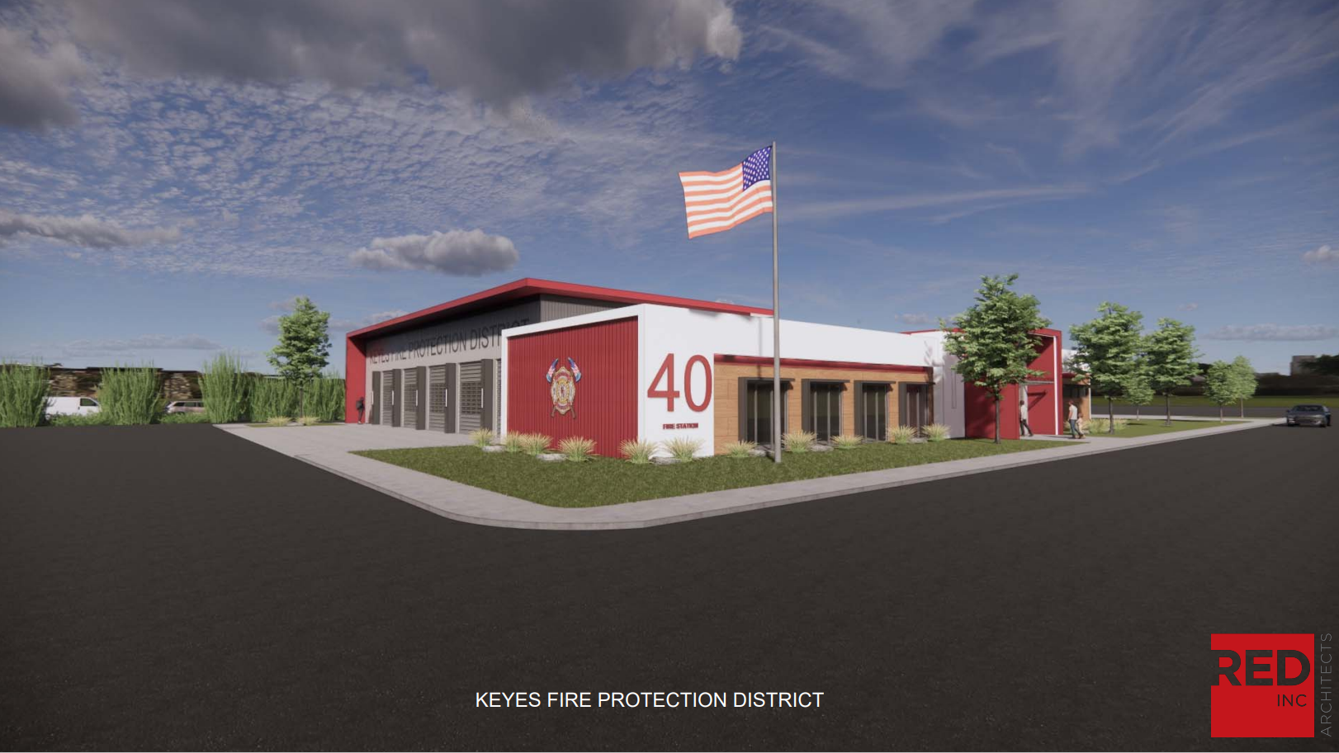

Slide 17
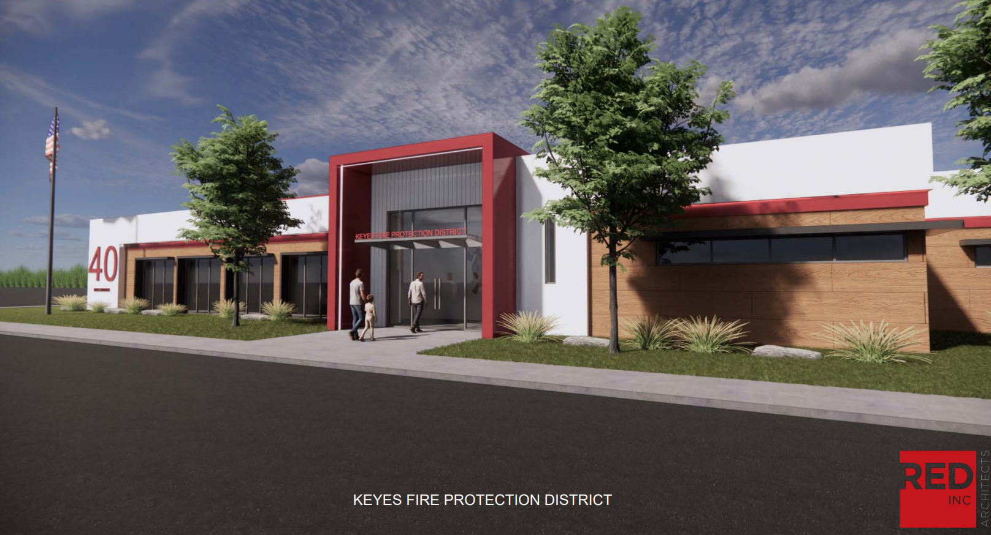

Slide 18
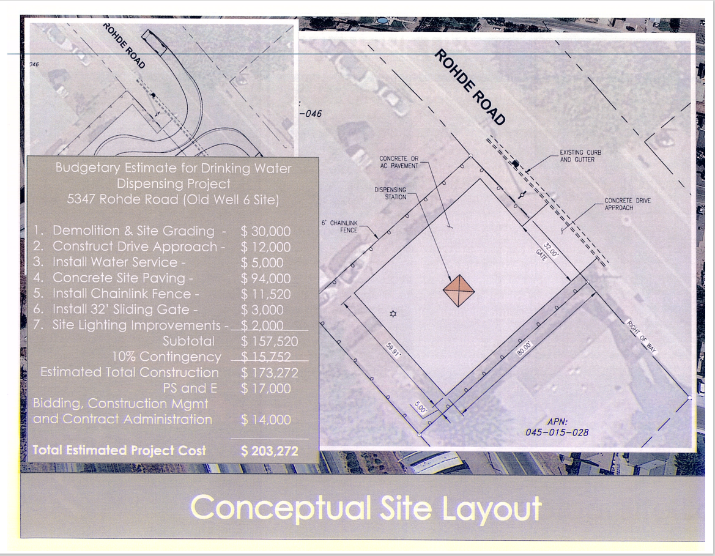

Slide 23
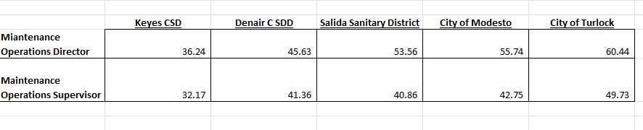
Comparison

Slide 24
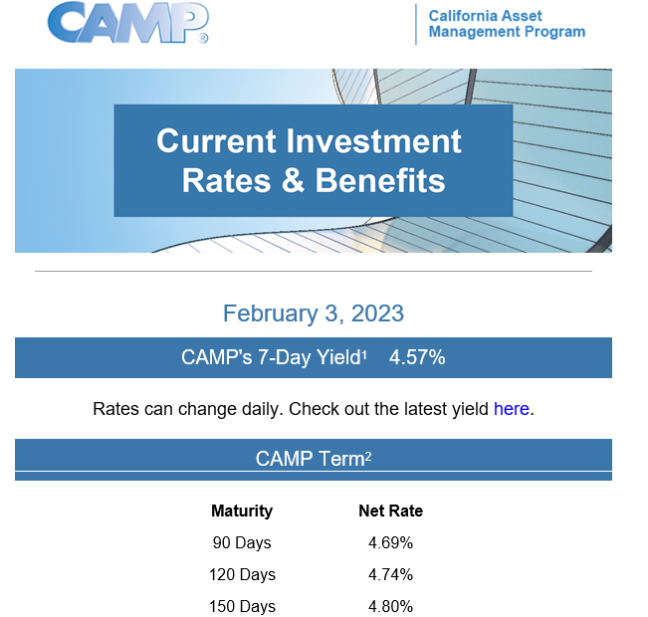
Optum Investment Proposal
CAMP Current Rates

Slide 25
Closing Remarks

